Slide 1
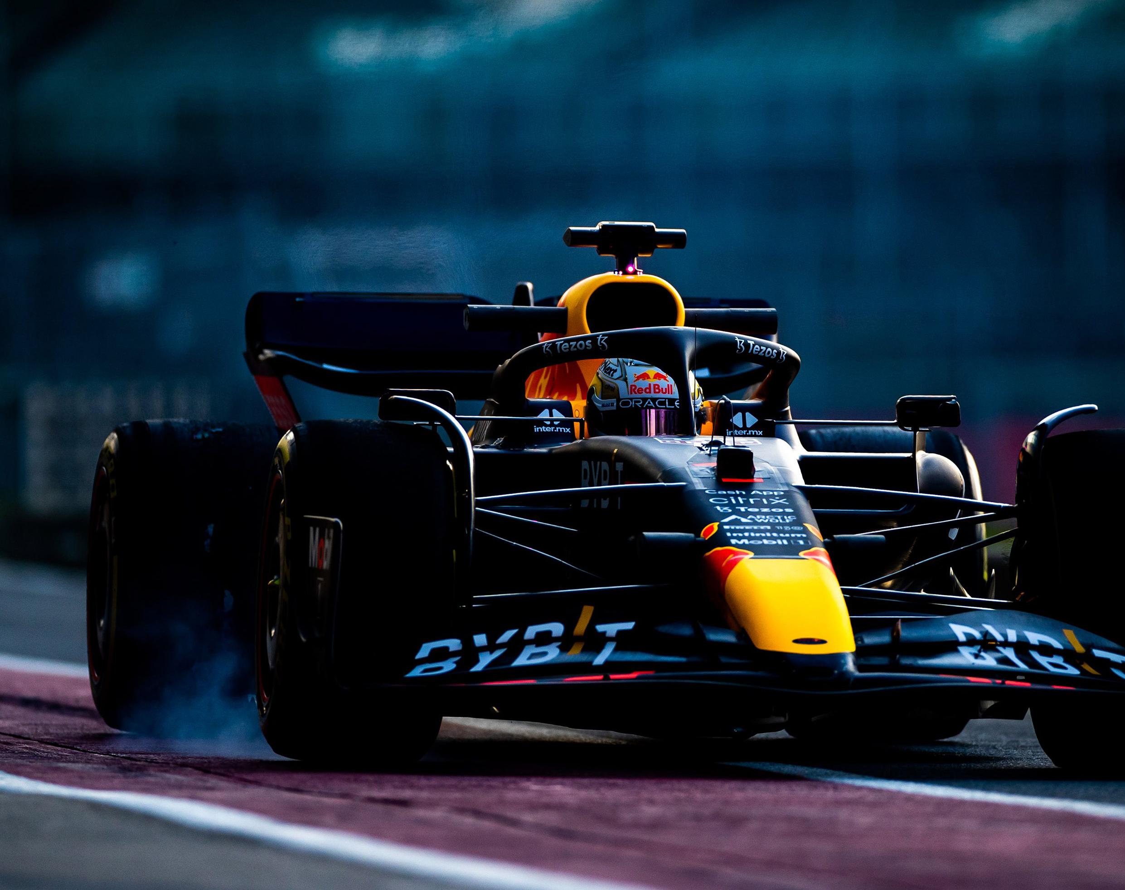
An Analysis of Formula 1 Results
Cole, Hunter, Ryan, Taylor, Talon

Slide 2
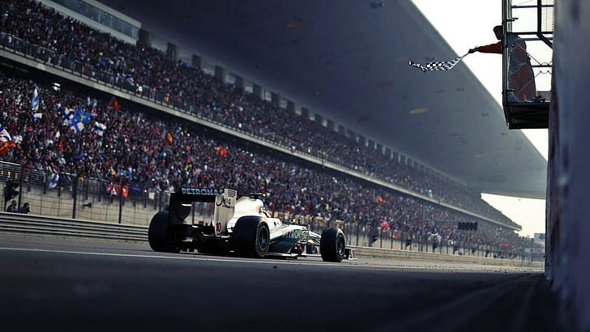
Intro
20 Drivers, 10 Teams, and One Race Winner
20+ Races a Year
Grand Prix Weekends consisting of Practice, Qualifying and Race Day
Pit Stops for tires, steering wheels or front wings
Weather Factors

Slide 3
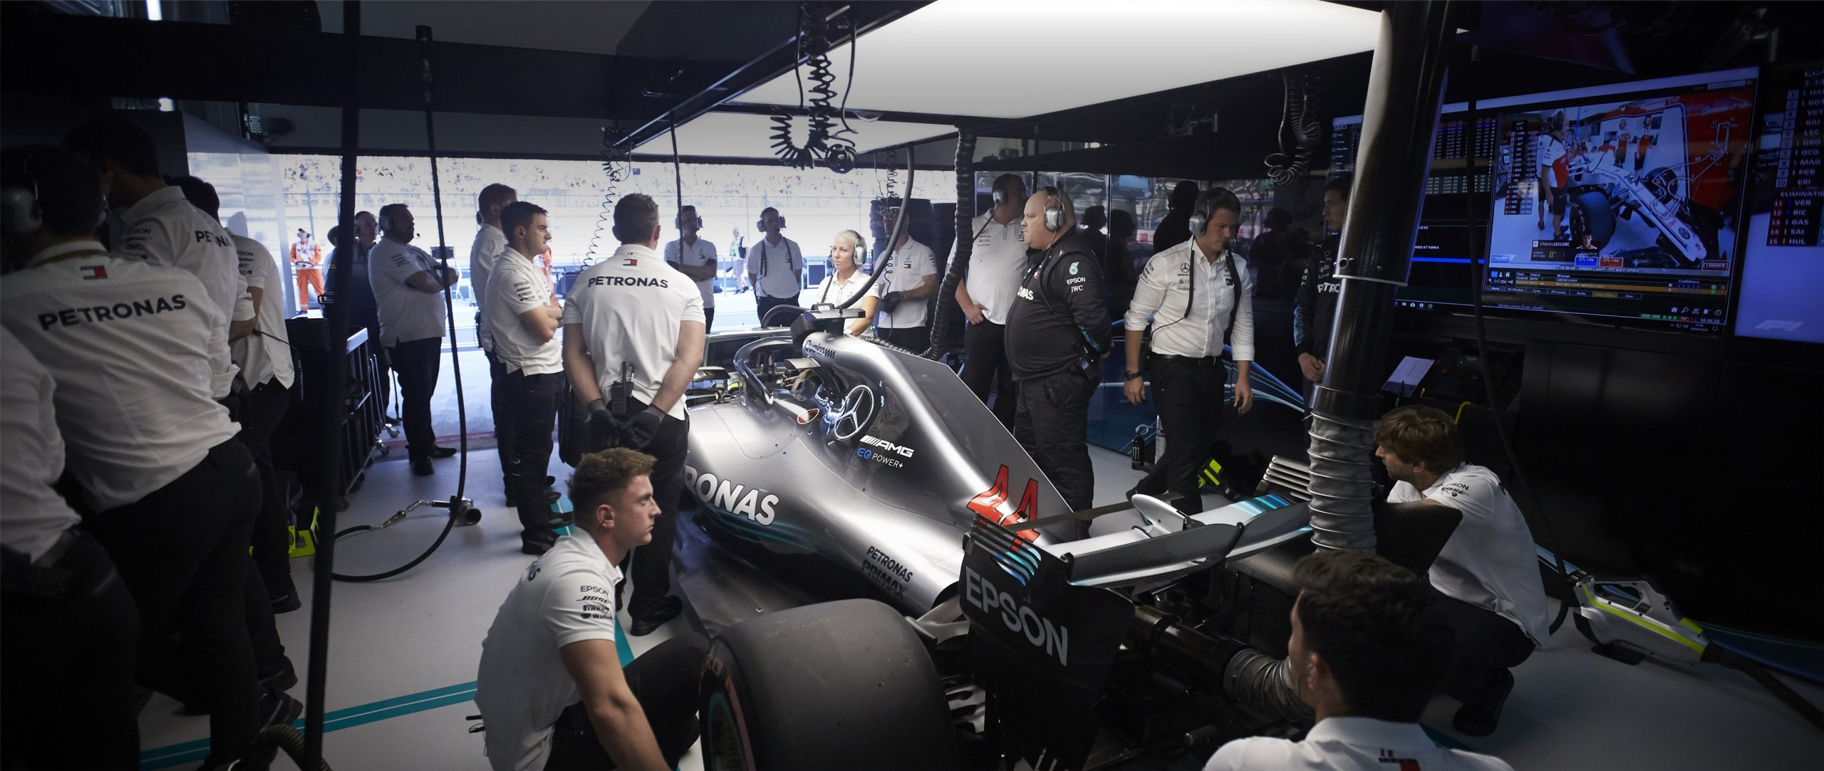
Questions to Answer
How much does the average pit stop time of a driver per race affect their finishing position?
How much does the starting grid position of a driver affect their finishing position?
How much does weather affect the average pit stop time and average driver finishing position?

Slide 4
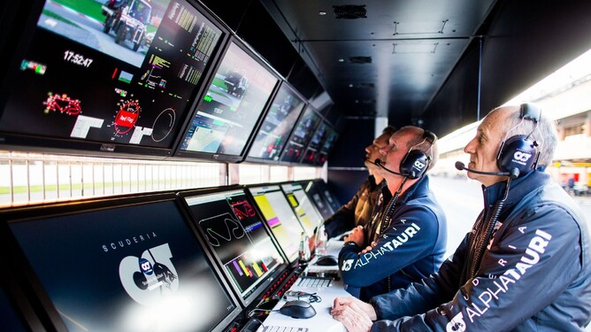
Hypothesizes
The faster the average pit stop time is for a driver in a race is, the better the driver will finish in the race
The better average starting position a driver has throughout a season, the better results a driver will have in the season
Weather evens out the grid and the drivers with faster pit stop times will have better finishing positions in the races affected by weather

Slide 5
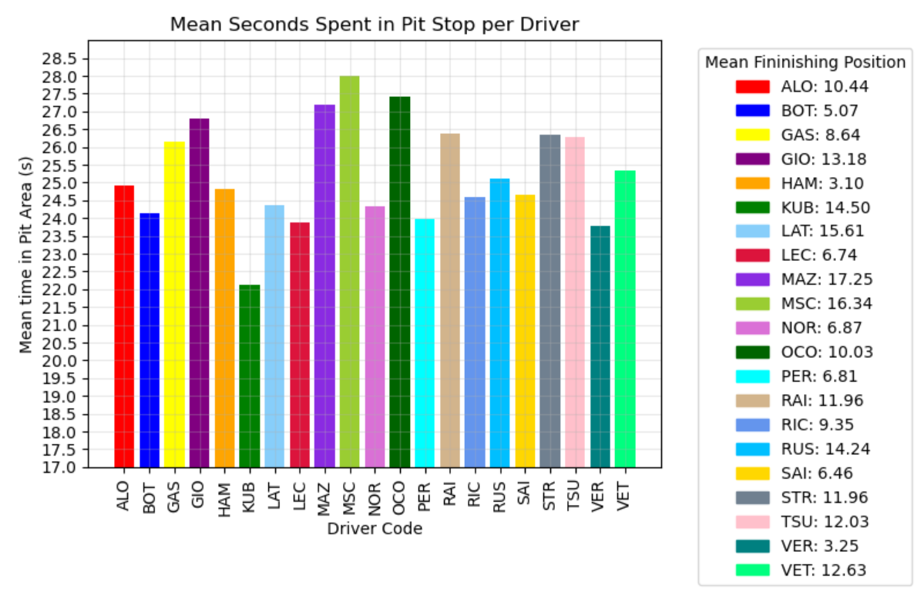
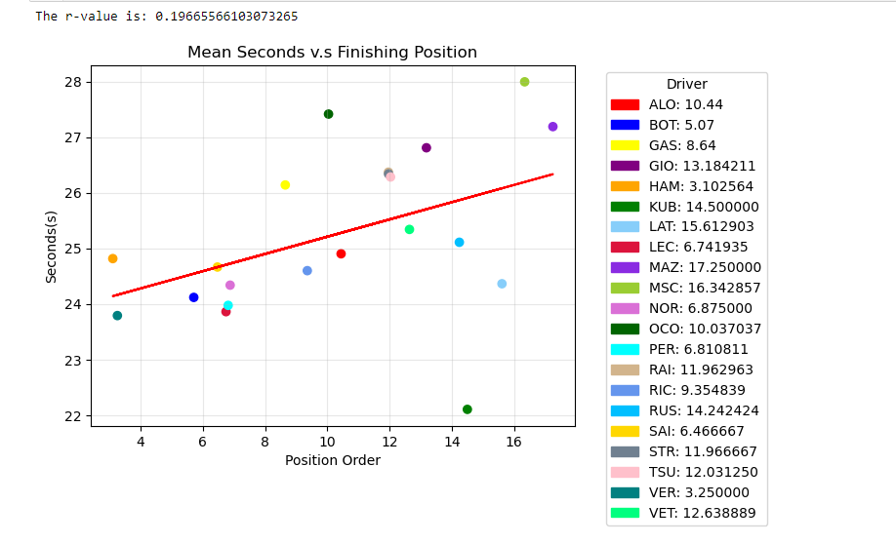
Question 1 Plots

Slide 6
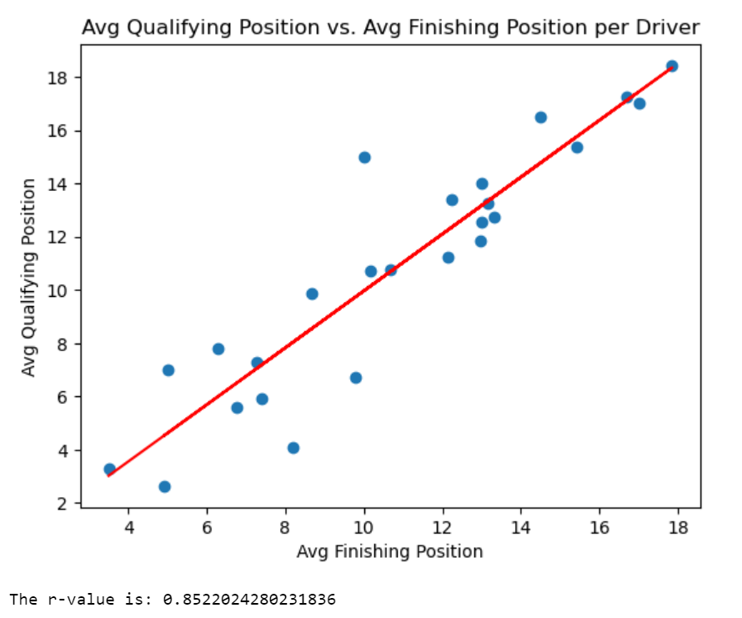
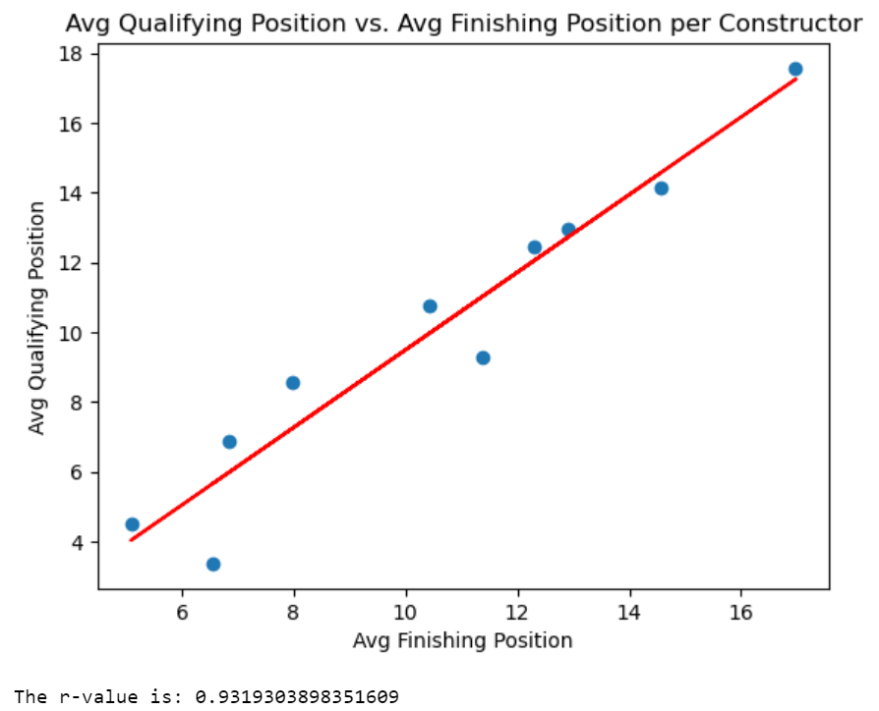
Question 2 Plots

Slide 7
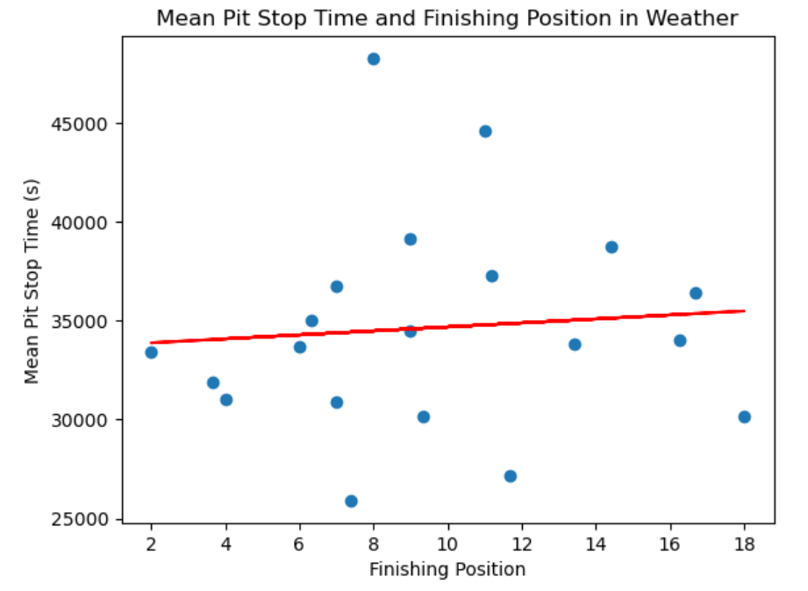
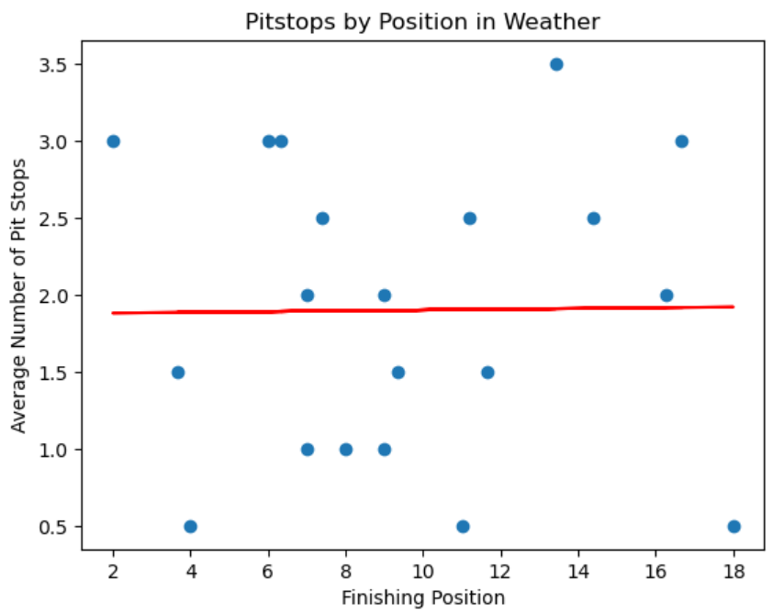
Question 3 Plots

Slide 8
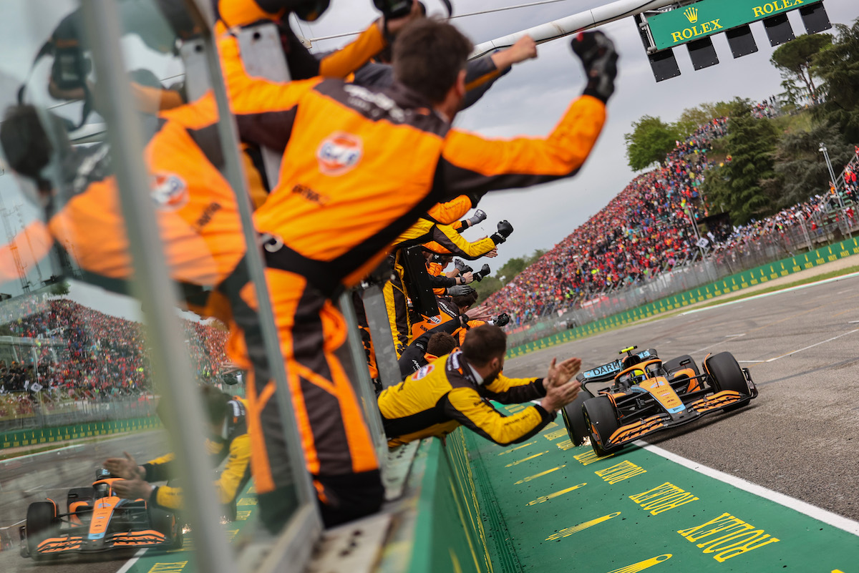
Conclusions
No true correlation between pit stop times and finishing position
Massive correlation between starting position and finishing position
Weather races remain constantly unpredictable

Slide 9
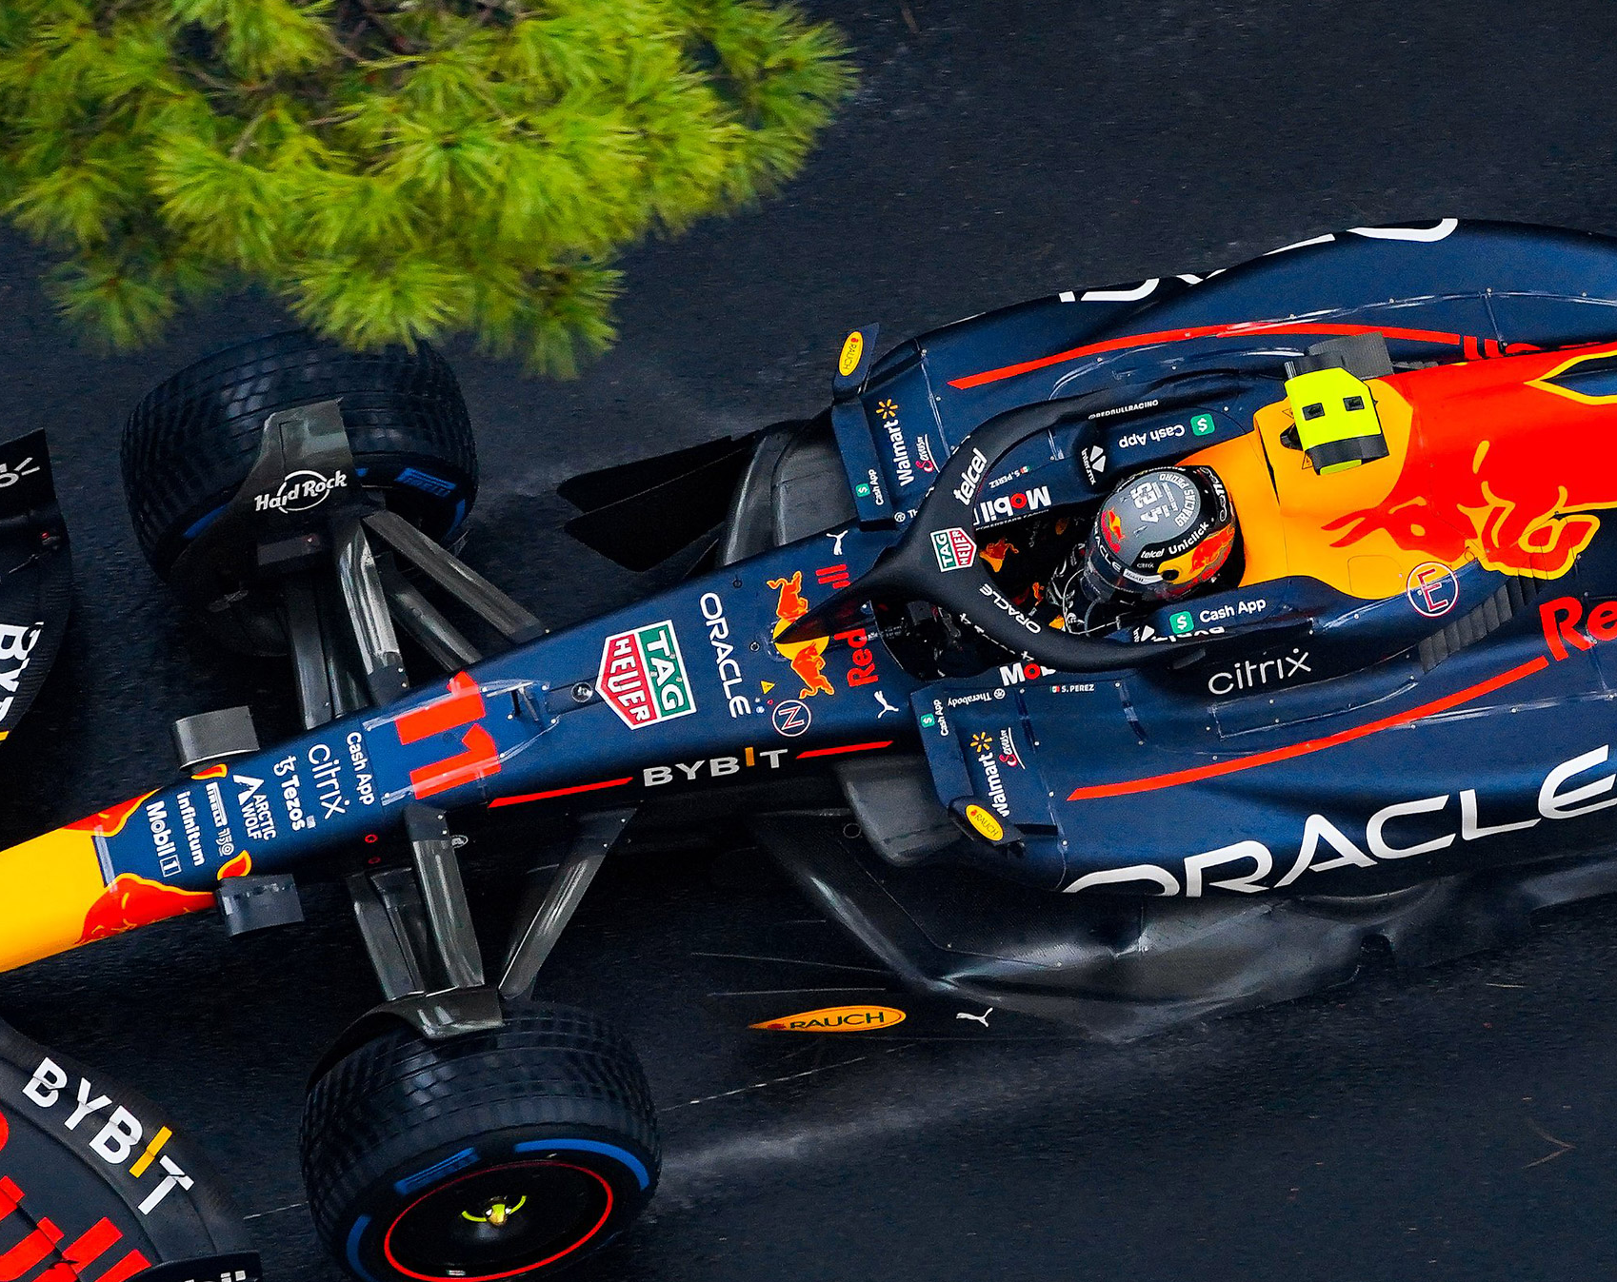
Thank You!

